Slide 1

WELLCOME TO OUR CLASS

Slide 2






UNIT 5: CAN YOU SWIM?
Lesson 2
ABILITIES

Slide 3
Warm up
What can you do?
Action Words - Talking Flashcards.mp4

Slide 4
00
01
02
03
04
05
06
07
08
09
10

Slide 5
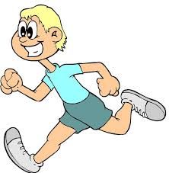



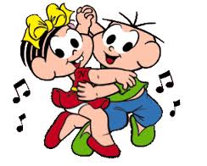
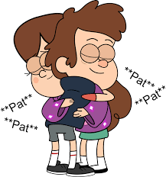
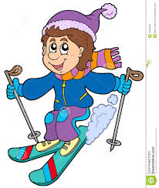

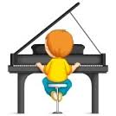
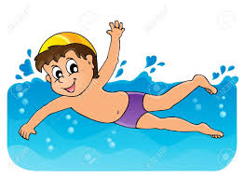
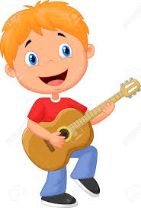


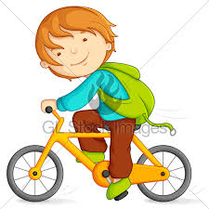


Slide 6
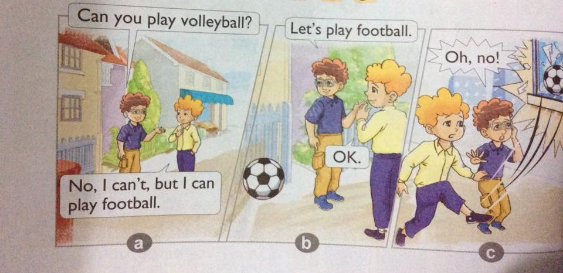

1. Look, listen and repeat

Slide 7
1. Look, listen and repeat
2. Point and say
* Model:
Can you play volleyball?
Yes, I can
No, I can’t
1. Meaning: Bạn có thể chơi bóng chuyền được không?
Có, tôi có thể./ Không, tôi không thể.
2. Usage: Mẫu câu dùng để hỏi xem người đối diện có thể làm gì và trả lời
3. Note: can’t = can not

Slide 8
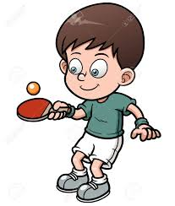
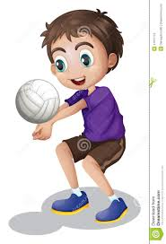


2. Point and say
Yes, I can
No, I can’t
Can you
a. Play table tennis
b. Play volleyball
c. Play the piano
d. Play the guitar

Slide 9
3. Let’s talk
Can you….? | Name:
Play table tennis
Play volleyball
Play the piano
Play the guitar

Slide 10
Can he/she play volleyball?
Yes, he/she can
No, he/she can’t

Slide 11
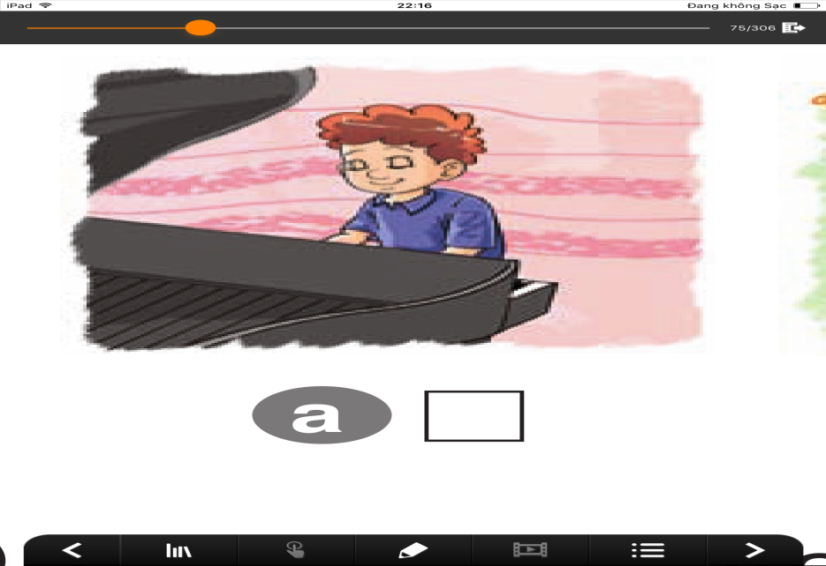
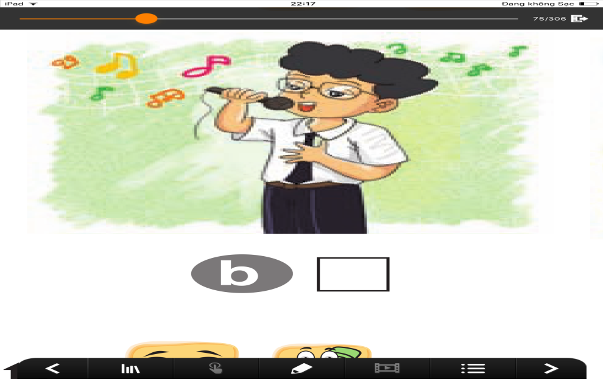
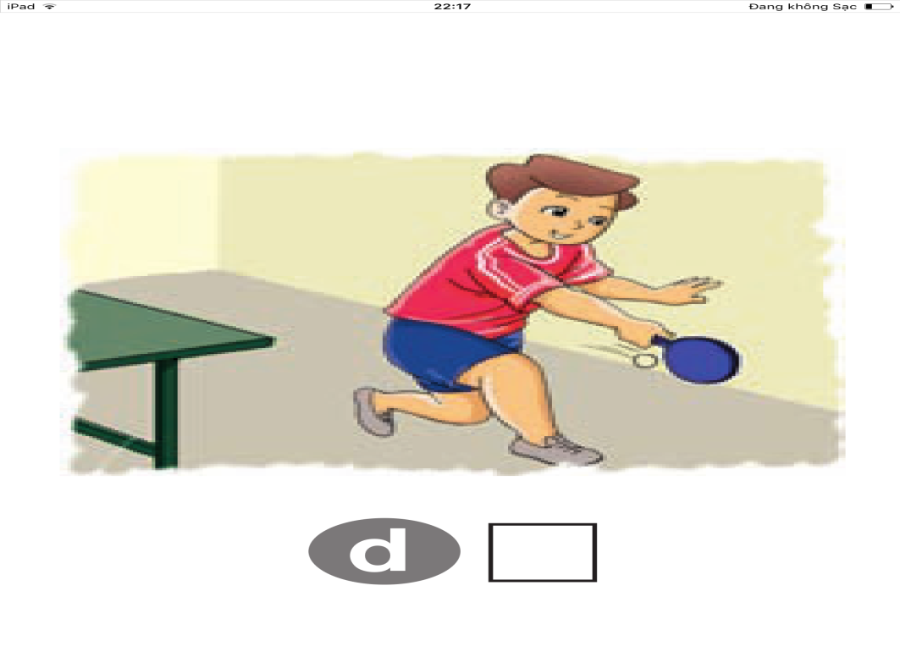
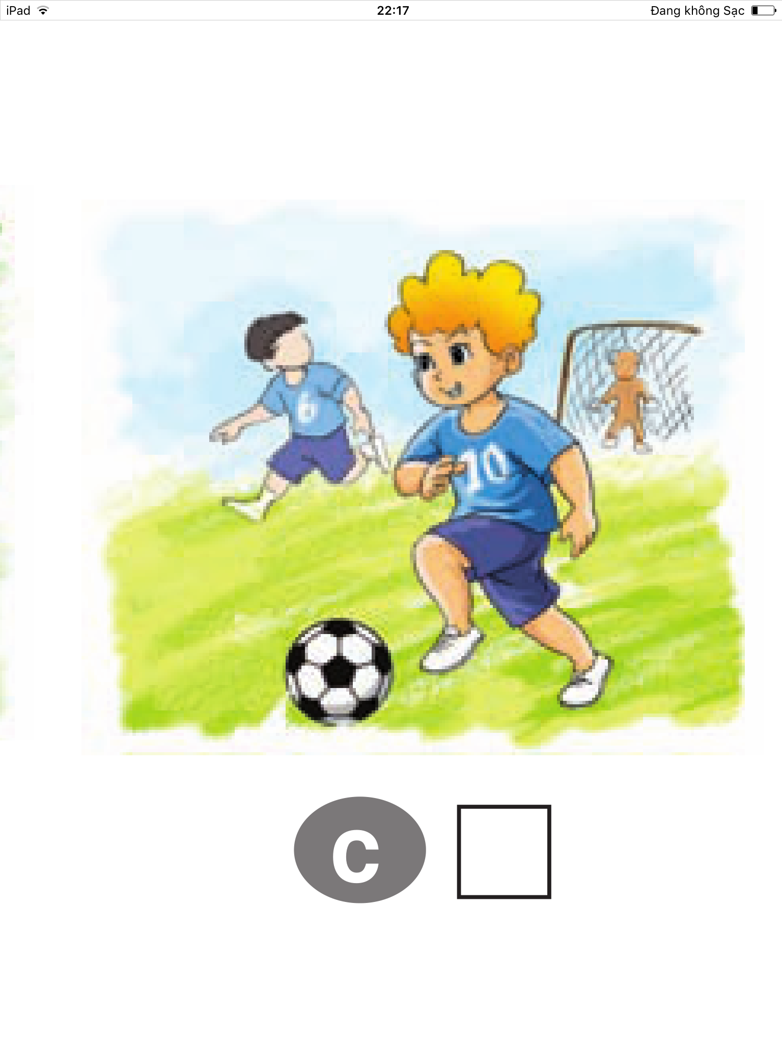
Listen and number
4. Listen and number
2
4
3
1

Slide 12
Game
Game
Can you….?
Yes, I can No, I can’t

Slide 13
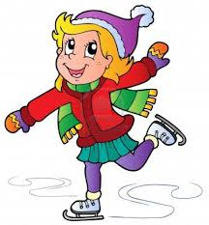
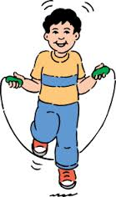

Can you…..?

Slide 14
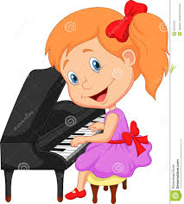

Can he/She….?

Slide 15

Homework
Do exercises in your workbook
Prepare new lesson

Slide 16


Slide 17


Warm up
00
01
02
03
04
05
06
07
08
09
10
What can you do?

